Slide 1

Xfinity
Analysis & Insights

Slide 2

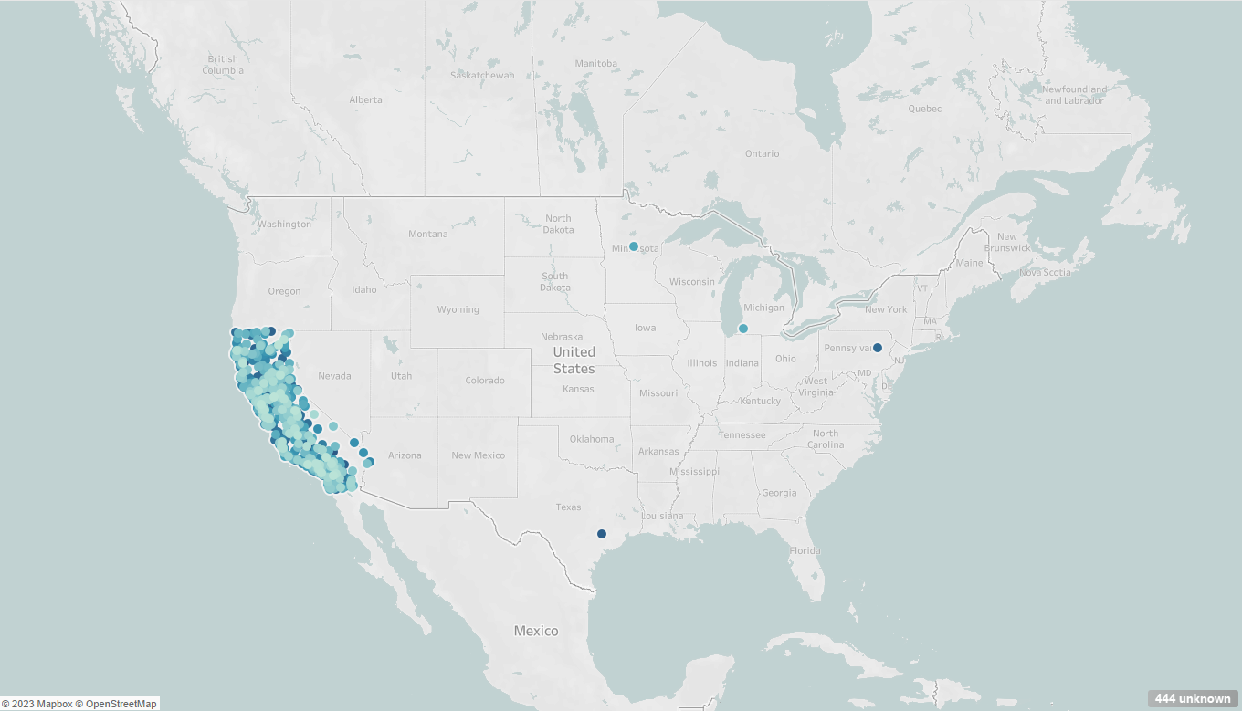

Customer Base
Mostly located in all of California
There is a small percentage of customers in Minnesota, Michigan, Texas, and Pennsylvania
Targeted approach to the problem
Notes:
The reason why I mentioned this is that I want you to know where your customers are so you can be targeted with your approach when applying these solutions.

Slide 3
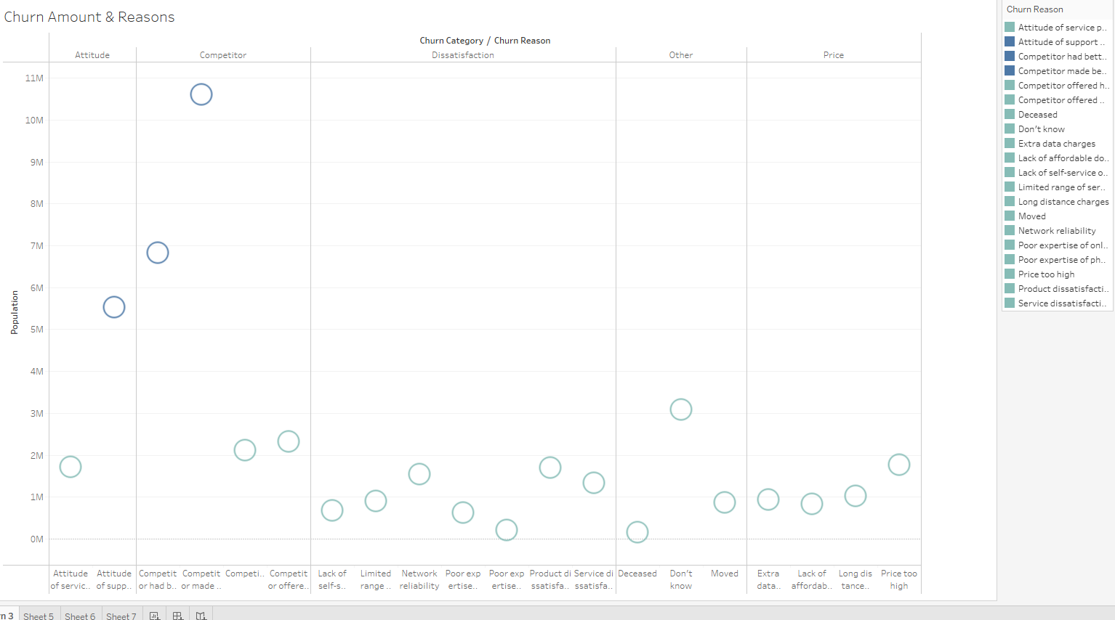
Problems
The Biggest cause of the churn is that the company is losing customers to competitors
Data shows that 10.6m people were getting better offers from competitors
Data shows that 6.8m people left to competitors that have better devices
Data shows that 5.5m people were leaving because of the attitude of your support staff
Notes:
It was more Men leaving then women.

Slide 4
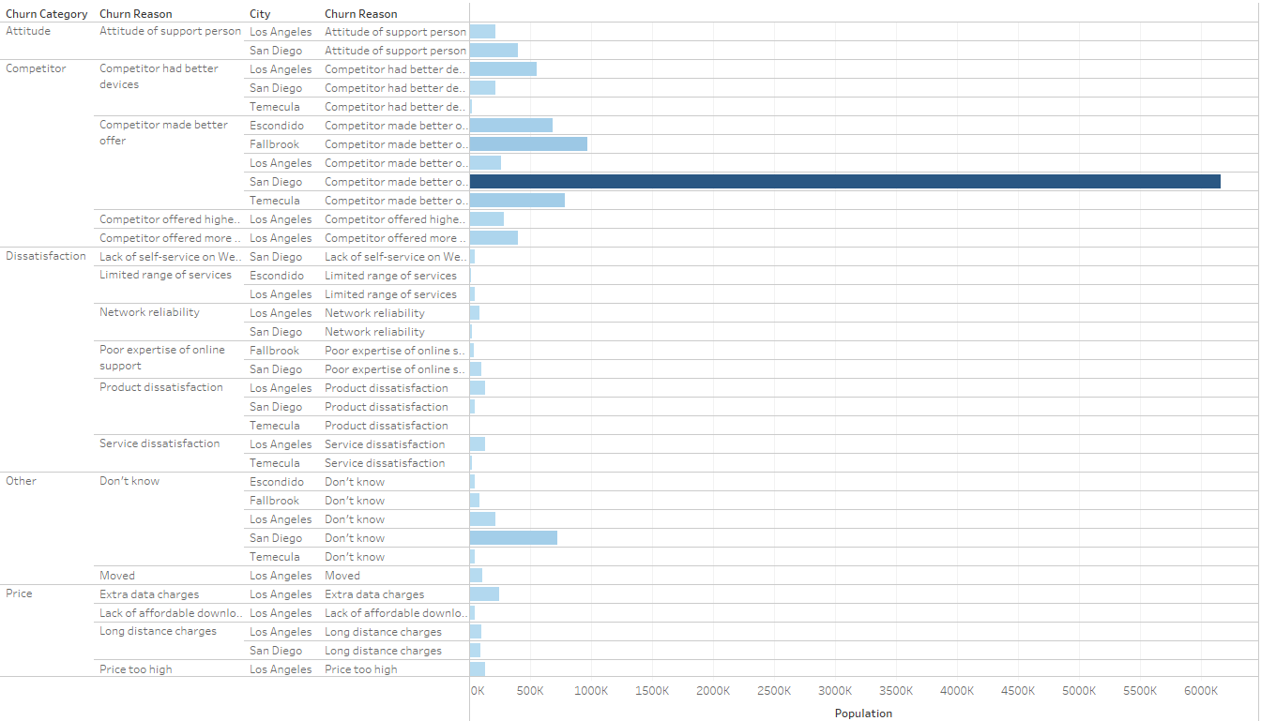
Top 5 City's that Churned
San Diego
Fallbrook
Temecula
Escondido
Los Angeles
Notes:
These City's are based just off the most losses due to competitors. San Diego being the biggest one in Attitude of support person and Better offer

Slide 5
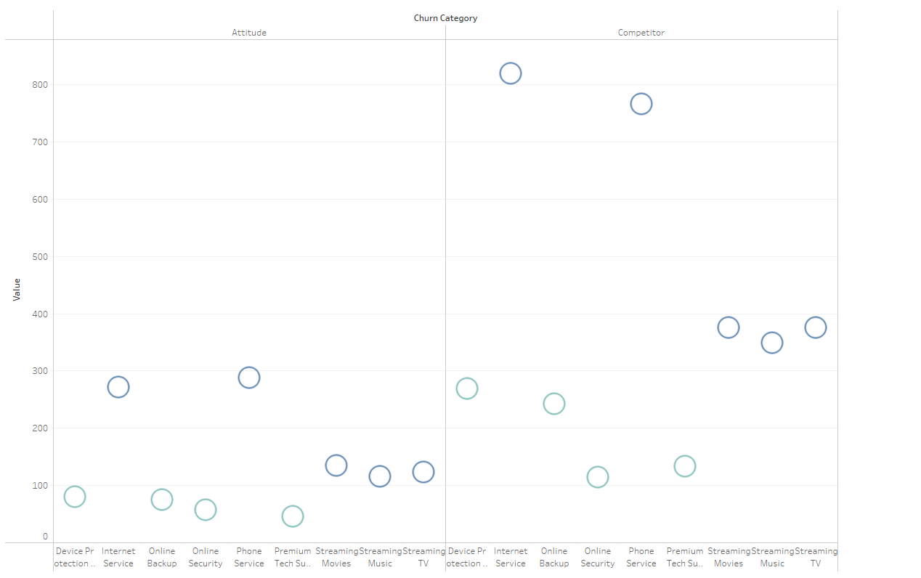
Services & Charges
Internet & phone Service had the biggest churn
There could be a Correlation to the attitude of support staff
Streaming Movies, TV, and music are also an issue

Slide 6
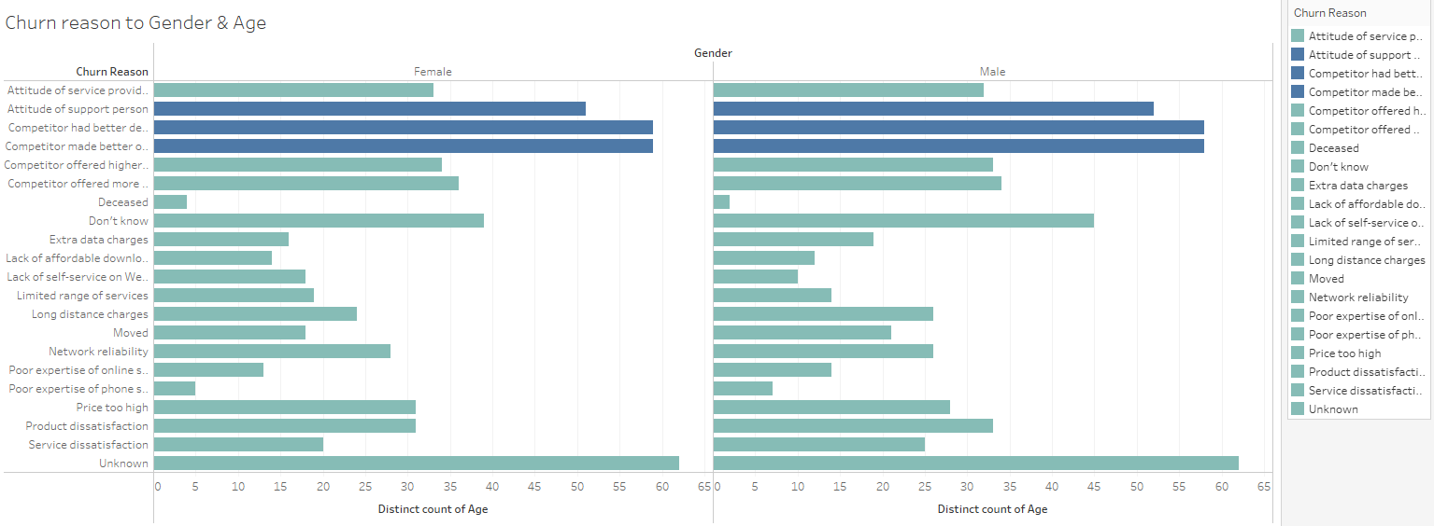
Gender & Age
It was an older age group between male and female
Between the ages of 51 -59
the most common ages that were leaving due to competitors

Slide 7

Thank you, Xfinity

